Slide 1
WHO WE ARE,
WHAT WE DO
Who We Are,
What We Do

Slide 2
SCA Research in a nutshell
We are a market research agency within one of Australia’s largest entertainment organisations
We use new research methods and innovative technology to lead to deeper insights
Our goal is to provide knowledge and information to empower winning business outcomes
Servicing the research needs of Southern Cross Austereo and its partners, SCA Research has evolved into a market research agency available to service external clients and agencies alike.
In our view – research and insights should enable a person or organisation to make more informed decisions, in turn leading to winning business outcomes. This is what we aim to provide for our clients.
SCA Research has been innovating in research methods and platforms for 10 years. We work with forward thinking partners and technologies, and have the first and largest entertainment Insight Community in Australia.

Slide 3
The sca research department’s point of difference
ACCESS
SCAR has access to large sample sizes at low cost including hard to reach samples of youth and male market segments.
DEPTH
Access
Depth
SCAR has large qualitative database built from radio and TV audiences which provide deep insights. These respondents are high quality due to their brand engagement with SCA radio and TV communities.
Agility
Breadth
AGILITY
SCAR is able to provide quick insights through deeper relationships with high quality respondents.
BREADTH
SCAR has the largest insight community in Australia of all ages and demographics.

Slide 4
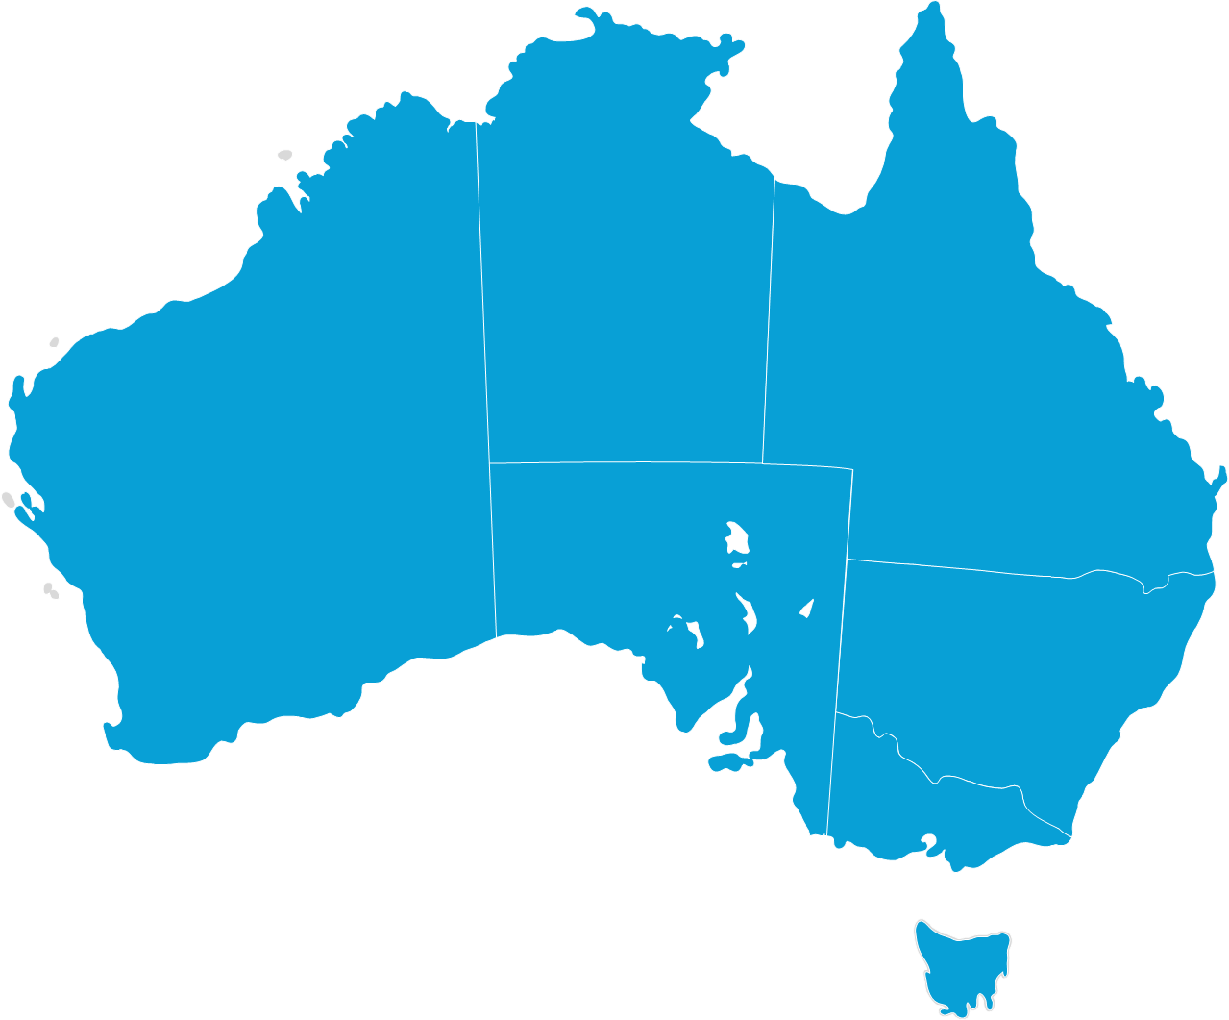
The sca research department overview
SCA Research is an end to end market research agency within a media organisation
National team based in Brisbane and a large CATI room and team located on the Gold Coast.
Eleven full time staff working on projects across Sales, Content, Regional, Marketing and Corporate. Plus a team of part time and casual staff.
Over 110 surveys conducted by the Sales team in 2017 alone.
On average this equates to over 2 surveys being conducted per week.
Large entertainment based databases which we can tap into. Plus great relationships with external sample providers.

Slide 5
WHO WE ARE,
WHAT WE DO
Our Structure
Sales Research Credentials 2018

Slide 6
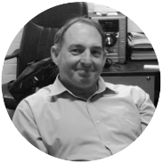
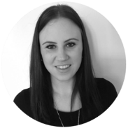
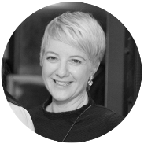
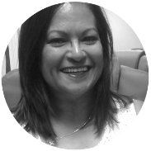
Team structure 2018
John Musgrove
National Research Manager
Jasmine Beech
Jenny MacLachlan
Sean Chan
Colleen Rolleston
National Sales Research Manager
Regional and Operations Research Manager
Content Research Analyst
CATI Room Manager
Kate Hough
Kate Ainsworth
Sabrina Poon
Phoebe Ingham
Senior Research Analyst
Junior Research Analyst
Casual Research Analyst
Senior CATI Telephone Operator
Rebecca Petrie
Sherie Meka
Samantha Laws
18 Telephone Operators
Senior Research Analyst (Casual)
Casual Junior Research Analyst
Casual Junior Research Analyst
Ines Obermair
Jane Ind
David Thomas
Research Analyst
Casual Research Analyst & Operations
Online Communities Manager (Part Time)
Taylor Casu
Intern
Research Analyst
Intern
Paige Giakoumakis
Research Analyst (Maternity Leave)
Alicia Federico
Junior Research Analyst
Melanie Cavanough
Junior Research Analyst

Slide 7
How We Conduct Research

Slide 8
HOW RESEARCH is perceived by the business
“In 2016 we ran a very successful campaign for Myer Father’s Day. Through our communities we identified Myer’s male audience want to engage with fashion through a trusted friend, not a celebrity or fashion influencer. We tested ambassadors and uncovered Merrick Watts was seen as a mate to Triple M listeners.
The campaign lived beyond SCA, featuring Merrick and his kids in the Myer Father’s Day catalogue and a fun content series. Through our communities we were able to measure the effectiveness of the campaign which saw Myer experience a record week of sales. Insights into our communities were paramount in helping us secure the Myer business and ensured we were able to demonstrate the effect of our campaign across both metro and regional Australia.”
“Our SCA communities give us a great 360 degree engagement with our core fans. They share with us how they feel about our music, our content and the things that matter most to them, we use those insights to shape our music playlists, curate our content offering, tailor promotional offerings to what they tell us they are interested in.
This provides them with a better radio product they help design which in turn allows us to always evolve with our fans (the consumer) front of mind.”
Mickey Maher,
Head of Content- Regional Radio
Lisa Levesque,
Head of Insights- The Studio
“The study has been great in that it has allowed us to delve deeper into understanding the female consumer. It has produced a number of valuable insights that can be used across the Hit Network enabling us to understand women better and ensure we position the brand and our content in an authentic way.”
“Our communities offer the best way to reflect what our audience truly think about issues of the day. We can ask for their thoughts on 457 foreign worker visas, who they’re voting for in an election, how much they’re planning to spend on Christmas presents, or even how much sleep they get – and know we get real engagement when this info’s shared on air and online.”
Gemma Fordham,
Head of Content- Hit Network
Natasha Jobson,
Metro News Operations Manager

Slide 9
METHODS USED
DID YOU KNOW?
GreenBook (the official global research tracking association) indicated in it’s 2014 Research Industry Trends Report that the 5 fastest growing research methods in the world today were Mobile Surveys, Online communities, Social Media Analytics, Text Analysis and Mobile Qualitative.
The above highlighted methods are already in use by SCA Research.
Text Analysis: SCA pioneered large qualitative based research for entertainment in Australia and continue to develop our own internal tools to review text responses and extract Key Word & Theme reports as well as quickly processing, sorting & filtering full qualitative reports.
Entertainment Insight Communities:
Insight Communities is one of leading research trends in world and SCA has the first and largest entertainment Insight Community in Australia with global attention. A growing trend led by major entertainment brands like Discovery Channel. With over 250,000 members SCA have one of the largest entertainment Insight Communities globally.
Mobile Research:
It is the leading research trend in the world currently and SCA has been delivering a full mobile survey compatibility for several years with all our online surveys fully mobile compatible.
CATI Room:
SCA is unique in having it’s own internal CATI (Computer Assisted Telephone Interviewing) resource. While most research is moving online these days, approximately 20% of the Australian population are not connected to the internet, and even if they are, a large percentage are not regularly online or members of online research panels. Furthermore, no panel provider in Australia effectively talks to regional Australia. Using CATI by itself or in combination with online research allows access to hard to reach demographics, as well as the views of regional Australians.
Source: GreenBook Research Industry Trends Report, 2014” http://www.greenbook.org/grit

Slide 10
SCA Research method – online surveys
INCENTIVISED
(BUT WANT TO HAVE THEIR SAY)
RESPONDENTS
RECRUITED VIA EMAIL
Respondents are recruited from Southern Cross Austereo Hit VIP and Triple M Club Communities. External Sample from SCA Research Panel Partners TEG Rewards and SSI is recruited when required. Only required respondents are recruited to take part in the study, ensuring relevancy and higher response rates.
Respondents are recruited via e-mail invite to take part in the survey. Each survey invite graphic is unique and eye-catching, and written to appeal to the target audience. Invites can be ‘blind’ if the category needs to remain unknown.
Respondents are incentivised for their involvement by a prize pool to participate – but research has found their motivators to respond go beyond prizes to wanting to have their opinion heard. Unlike external panels, SCA research communities are not paid for each study they participate in, so we receive quality responses as respondents do not skim through to earn points.

Slide 11
WHAT IS AN INSIGHT COMMUNITY?
Southern Cross Austereo’s communities allow real time access to your fans, customers and audiences. Communities are all about people – their passions, their emotional connections, and their interactions, not only with each other, but with the brands they love.
To compete successfully in media today requires a much better understanding of your audience. You need to be in constant conversation with them, and listening to determine what they are thinking, doing and talking about right now that impacts you.
With fads and trends regularly coming and going, its fair to say that what’s hot today, may be very cold tomorrow. The only way for media to keep in touch with their audience, and have a finger on their pulse is to have an almost daily ear on their conversation.
It’s a group of individuals with common interests who use the Internet to communicate, share, work together and pursue their hobbies, likes and dislikes.

Slide 12
SCA RESEARCH COMMUNITIES & PLATFORMS
170,000
Metro Hit VIP
100,000
Metro Triple M/Mix Club
297,000
Airtime
Used for Music Research for Content teams
15,000
Metro Hit VIP
12,000
Metro Triple M/Mix Club
119,000
Vision Critical
MROC (Market Research Online Community) which is used for client studies
2018 Winner of Vision Critical Business Transformation Award
49,000
Regional Hit VIP
41,000
Regional Triple M/Mix Club
2,000 Entertainment Spot

Slide 13
OUR COMMUNITIES…
Largest Vision Critical insight
community in
ASIA-PACIFIC
2nd largest media Vision Critical
insight community WORLDWIDE
2018 winner of Vision Critical BUSINESS TRANSFORMATION Award

Slide 14
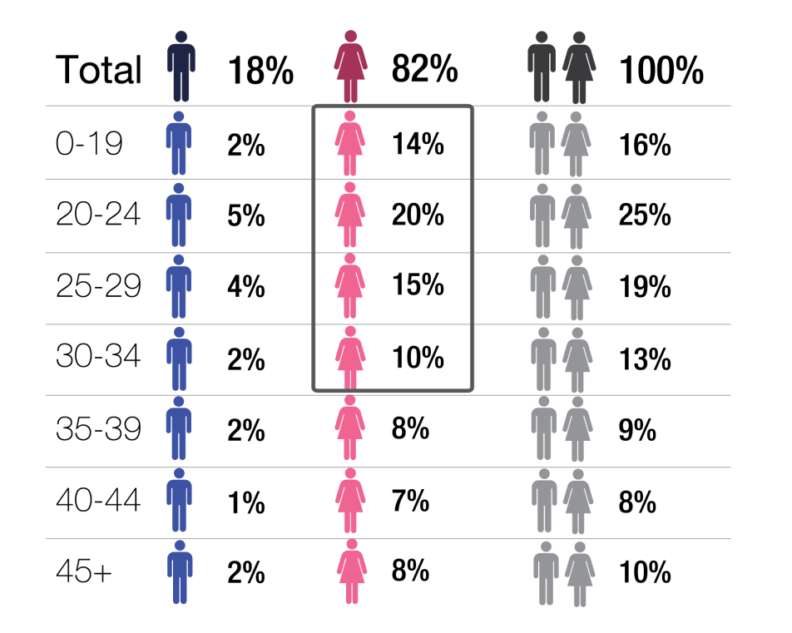
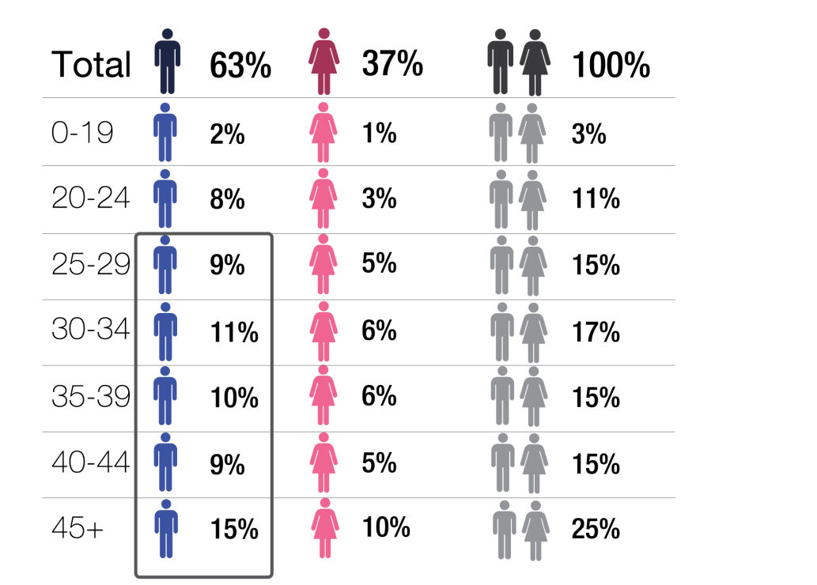
COMMUNITY AUDIENCE
WHEN USED TOGETHER, THE SCA COMMUNITIES ARE A REPRESENTATIVE CROSS-SECTION OF THE POPULATION
WHO THEY ARE
Each database reflects it’s network’s target listener. Being a part of these databases allows members to ‘have their say’ about the music played on their local station. It gives them access to exclusive competitions, random giveaways and opinion poll/survey opportunities.

Slide 15
CATI Research Computer assisted telephone interviews
Located on the Gold Coast, Southern Cross Austereo’s CATI (Computer-Assisted-Telephone-Interviewing) room is one of the few remaining telephone survey facilities still operating in Australia. SCA’s CATI has a particular focus on reaching people in regional Australia & is used by Commercial Radio Australia to conduct field work for the official regional radio surveys.
Questionnaires can be designed internally and coded in a short space of time ready for in-field survey recruitment. It offers brands the opportunity to talk to people across Australia and receive a topline look at a particular industry relatively quickly.
Operating as Entertainment Research, the CATI room will phone potential respondents Monday to Friday from 8:30am-7:30pm.
Businesses can use the CATI room for tracking campaigns and brands and gauging perceptions on an industry. It is a particularly effective method of surveying regional markets and getting a wider market view.

Slide 16
DATA AVAILABLE
REFERNCE DATA
INDUSTRY DATA
Radio Metro Surveys
Gfk Radio Ratings (Eram)
Radio Regional Surveys (Limited) – Xtra Insights (Frequency)
Regional OzTam TV Data – Arianna
Adex Data – AdViews
Nielson Online Data – Site Census/ Market Intelligence/ NetRatings
Nielsen CMV- Omnibus
IBISWorld- Market Research, Analysis and Forecasts
Trendwatching - World Wide Trends Database
Harvard Business Review -Business Articles
RAB UK - British Radio Resource & Information
RAB USA - US Radio Resource & Information
INTERNAL DATA
SCA Bespoke Studies – VisionCritical Sparq
Weekly Music Data - Analyst
Weekly Qual Questions

Slide 17
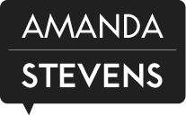
SCA RESEARCH PARTNERS
PLATFORM PROVIDERS
XTRA INSIGHTS
Xtra Insights is SCAR’s database management partner, and is highly involved in managing data for the Networks’ weekly music research. Established in 2003, Xtra Insights is an entertainment research company working with radio groups, TV Networks and music labels in Australia, NZ, Canada, Asia and Europe.
PROJECT PARTNERS
THE LAB
VISION CRITICAL
The Lab has been SCAR’s research partner for the last 6 years. The Lab specialises in brand research and consumer interactions. This is facilitated through in depth one on one interviews as well as focus groups and online surveys.
Vision Critical provides SCAR’s online database platform, which facilitates research for both content and larger sales related projects, such as brand and campaign tracking as well as category perceptual surveys. We have a close working relationship with VC’s Managing Director, Peter Harris (Also the National President for the AMSRS).
AMANDA STEVENS
Amanda Stevens is n award-winning speaker, author and marketer – and the authority in marketing to women. Amanda works with Today’s hit Network on understanding its female audiences through focus groups, and consults with the team on various projects.

Slide 18
PANEL PARTNERS
DID YOU KNOW?
Southern Cross Austereo not only has its own dedicated research department, but also has close partnerships with some of the research industry’s leading companies.
PANEL PROVIDERS
TEG REWARDS
SSI
TEG Rewards do most of the external recruitment for the SCA Networks’ weekly music research. Established in 2007, TEG Rewards is one of the largest online access panels with over 1.4 million members across Australia.
SSI also provide the external recruitment for our networks’ weekly music research, as well as for client, market and industry studies. Celebrating 40 years since its original foundation SSI boast an online panel of more than 11 million panellists in over 100 countries world wide.
CINT
LIGHTSPEED
PUREPROFILE
Cint hosts 25 million registered consumers worldwide and maintains an online insights exchange platform that connects community owners to researchers, agencies and brands, for the sharing and accessing of consumer data.
Lightspeed GMI have been utilising online research since 1996 and are a trusted global partner for digital data collection. Lightspeed conduct research in more than 45 countries and reached more than 5.5 million panel members in 2014.
Pureprofile collects deep profiles of consumers and provides clients the ability to segment and target niche customer segments and engage with them. Since 2002, more than a million people have chosen to join Pureprofile to share their opinions.

Slide 19
Sales Research
Sales Research Credentials 2018

Slide 20
THE THREE PILLARS OF ‘SALES’ RESEARCH
DAY TO DAY
BUSINESS SUPPORT
CLIENT CAMPAIGN EFFECTIVENESS STUDIES
BESPOKE CLIENT
STUDIES
SCA Research provides day to day business support to the Sales Teams through a variety of offerings and support tools:
Responding to ‘Red Button Briefs’ submitted via the Research Site using existing desk research tools;
Push methods: Regular Did You Know e-mails and Monthly Newsletters (Case Studies, Sponsorships Studies, Category Studies), one pagers and VBR documents.
Pull methods: The Research Site, SCA Engage Updates, responding to daily requests for support.
SCA Research provide research support to the Sales Teams and its clients at all stages of the campaign process:
Planning a campaign:
Market, Industry and Consumer Studies;
Micro Studies;
Creative Testing.
Improving upon a campaign:
Brand/Sponsorship Tracking;
Creative/Offer Testing.
Evaluating the success of a campaign:
Brand/Sponsorship Tracking;
Campaign Effectiveness Studies.
SCA Research is available to provide agencies and clients with non-campaign related research to allow them to understand their audiences and market:
Bespoke market, industry and consumer studies;
Micro studies;
Creative testing (radio or other);
Focus groups;
Omnibus questions.

Slide 21
SCA RESEARCH LOOKS AFTER YOUR PROJECT END TO END
2. CONDUCTING THE RESEARCH USING A VARIETY OF METHODS & PLATFORMS
CATI, Online surveys, Creative testing, Focus groups
1. PROJECT SCOPING, QUESTIONNAIRE WRITING & DESIGN
4. REPORTING, WORKSHOPPING
& PRESENTATION
3. DATA ANALYSIS
Infographics, Visual presentations, Brand clouds, Comprehensive reports, Heat mapping

Slide 22
OUR SUITE OF OFFERINGS
Micro Studies
Campaign Effectiveness Studies
SCA Research’s Micro Studies are conducted to produce a brief snapshot of a category, product, client, demographic or occasion.
Measuring the effectiveness of any advertising is imperative to determine your return on investment, but it’s also difficult and often expensive.
SCA Research has developed its own unique methodology for being able to measure brand awareness, perception movements and actionable outcomes created by advertising in any main media.
Marquee Studies
Micro Campaign Effectiveness Studies
SCA Research proactively conducts in depth research on key topics selected by Sales stakeholders through year.
Micro version of a campaign effectiveness study. It takes 5 mins to complete, as opposed to 10-12 mins. Designed for smaller campaigns or brands with a narrow competitor set.
Perceptual Studies
Brand Tracking Studies
SCA Research regularly conducts consumer, market or industry studies for its clients to help them understand their customers and their path to purchase, the competitive landscape and identify opportunities and threats to their business.
SCA Research can conduct Brand Tracking on behalf of clients. These studies track how the brand is performing against its competitors, and is usually conducted at least every second year, or annually.
Focus Groups
Creative Testing
A relatively new additional to the SCA Research suite of products. We can now conduct focus groups on behalf of clients. These deep dive into a particular challenge or observation, and are usually conducted in conjunction with a perceptual study.
The effectiveness of any advertising is almost always dependent upon how powerful and creative the actual message is. SCA Research can test creative before the campaign goes to air, to help determine what tweaks might need to made.

Slide 23
CLIENTS WHO SCA RESEARCH HAVE WORKED WITH

Slide 24
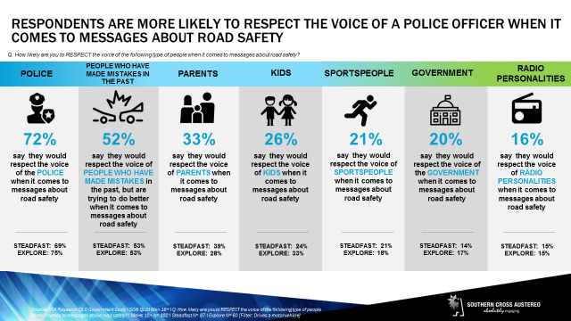
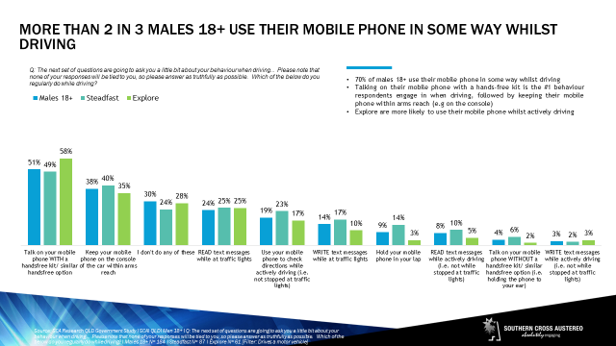
MICRO STUDIES
SCA Research’s Micro Studies are conducted to produce a brief snapshot of a category, product, client, demographic or occasion.
They can be used to assist in client pitch’s, for clients to quickly understand their audience and thoughts towards their brand or product offering, to test a hypothesis or simply gain a quick insight into the SCA Audiences.
Community members are invited via e-mail invite and incentivised to complete the survey.
Provide a quick snapshot of a category, audience or occasion
Take under 5 minutes to complete
Up to 8 questions
Quick turn around and low cost

Slide 25
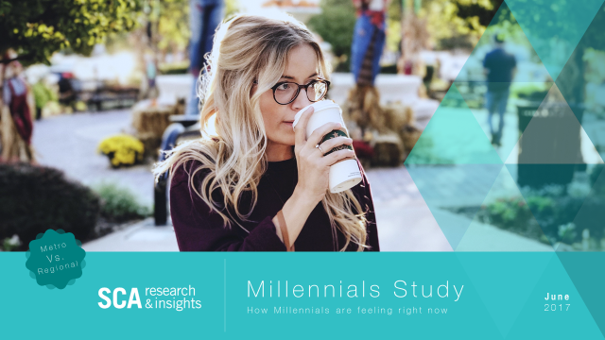
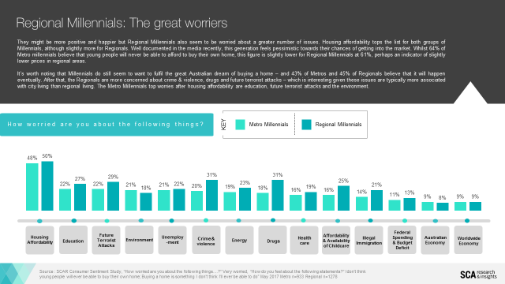
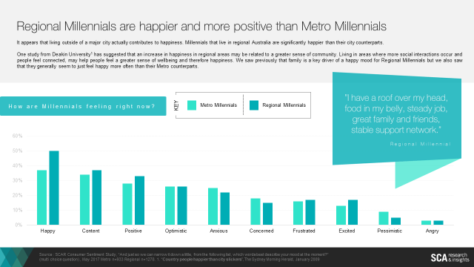
MARQUEE STUDIES
SCA Research proactively conducts in depth research on key radio topics selected by Sales stakeholders through year.
Many of these studies have been widely distributed in the marketplace and gained media coverage. Some of these key major studies are:
MOOD MONITOR
SCA Research started to track the mood of Australia in 2013 with a bi-yearly report. The ‘Mood Monitor’ differs from typical Consumer Confidence reports by looking at how people are feeling. A person’s mood can influence their spending behaviour, so it is important for SCA and it’s clients to understand the mood of Australians, what they are worried about, what is effecting them at the moment.
CHRISTMAS & SUMMER MEDIA STUDIES
Since 2009, SCA Research has been conducting research into Christmas spends and behaviours, and media consumption over Summer. From early December to early January, radio is ‘out of survey’, and there is no official ratings in order to understand radio consumption over this time. The SCA Research Summer Studies validate what many in the radio industry thought but could not prove – that many people maintain or increase their listening over Summer, as they are out and about more and radio enhances the summer lifestyle. The Christmas reports have helped bring Christmas spending forward and continue to be a key sales resource.

Slide 26
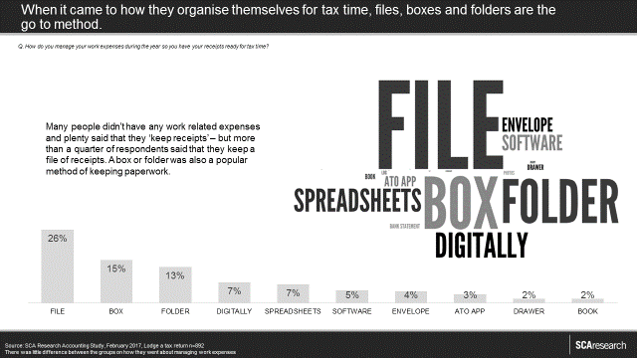
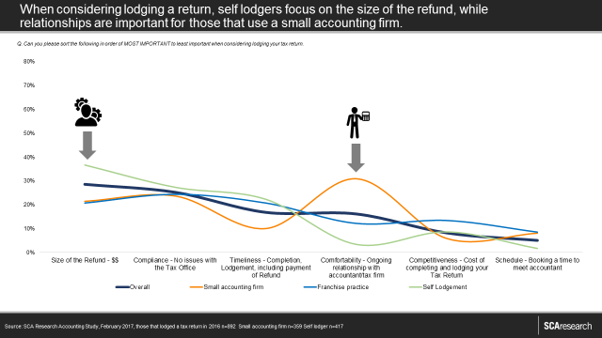
Client market/ consumer/ industry studies
SCA Research regularly conducts consumer, market or industry studies for its clients to help them understand their customers and their path to purchase, the competitive landscape and identify opportunities and threats to their business.
Our large national database allows us to get very robust results that can be drilled into for the views of smaller specific groups of consumers. SCA Research also regularly partners with our external panel partners for these projects to ensure a complete market view. These studies have allowed clients better understand their business, the category in which they operate, and their consumers in order to communicate with them more effectively and offer a superior product.
RECENT EXAMPLES:
FINANCE APP
SCA Research helped a start-up gauge the current behaviour of the market through a micro study in Perth. We were able to communicate the behaviour and what people are looking for when it comes to this type of app.

Slide 27
CAMPAIGN EFFECTIVENESS STUDIES (CES)
THE BELOW DEMONSTRATES THE METRICS SCA RESEARCH WILL COVER IN THE RESEARCH. ADDITIONAL QUESTIONS MAY BE ASKED DEPENDING ON THE LENGTH OF THE SURVEY AND INVESTMENT.
Brand Perception
Brand saliency with audience
Key brand positions, statements and positions (against competitive set) ie ‘is a quality brand’
Advertising Recall (Prompted) and Action (Post Only)
Prompted advertising recall (any main media)
Simple creative testing
Actions as a result of the ads
Brand Awareness and Usage
Brand and competitive set awareness (un-prompted and prompted)
Brand and competitor usage and consideration
Advertising Recall (unprompted)
Unprompted advertising recall on any media (against competitive set)
Where they recall the advertising
Main message cut through
METHODOLOGY
In analysis, respondent are split into two groups based on prompted advertising recall – a control group (do not recall the tested advertising) and a test group (recall elements of the campaign).
Respondent has no awareness of what client the survey is for while answering these questions.

Slide 28
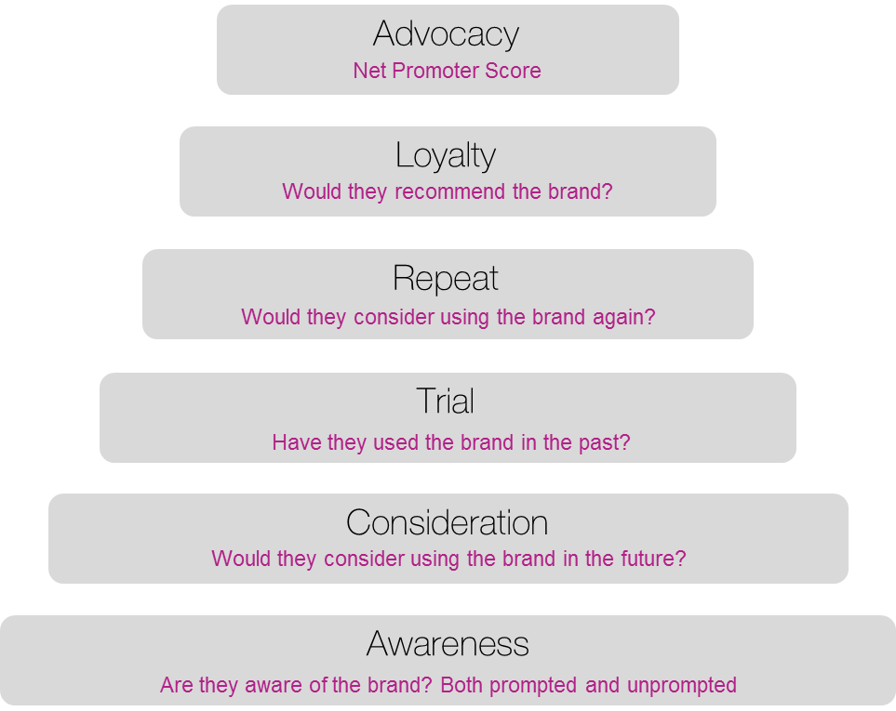
Campaign effectiveness studies (ROI) studies
Measuring the effectiveness of any advertising is imperative to determine your return on investment, but it’s also difficult and often expensive.
SCA Research has developed its own unique methodology for being able to measure brand awareness, perception movements and actionable outcomes created by advertising in any main media.
Campaign effectiveness studies are a key client research offering and have been heavily used by major clients and agencies over the past 3 years. They are a quick, cost effective way of measuring the effectiveness of a campaign above and beyond sales figures.
CAMPAIGN EFFECTIVENESS STUDIES TEST
Brand awareness (un-prompted and prompted)
Competitive set awareness
Brand consideration/loyalty
Brand Saliency with our audience
Specific brand objectives – a brand I can trust, a local brand etc.
Statement associations for brand footprint development with our audience
Information search and discovery
Campaign awareness
Creative cut through
Action outtakes as result
Propensity to purchase
Depth of engagement and action as a result of ads

Slide 29
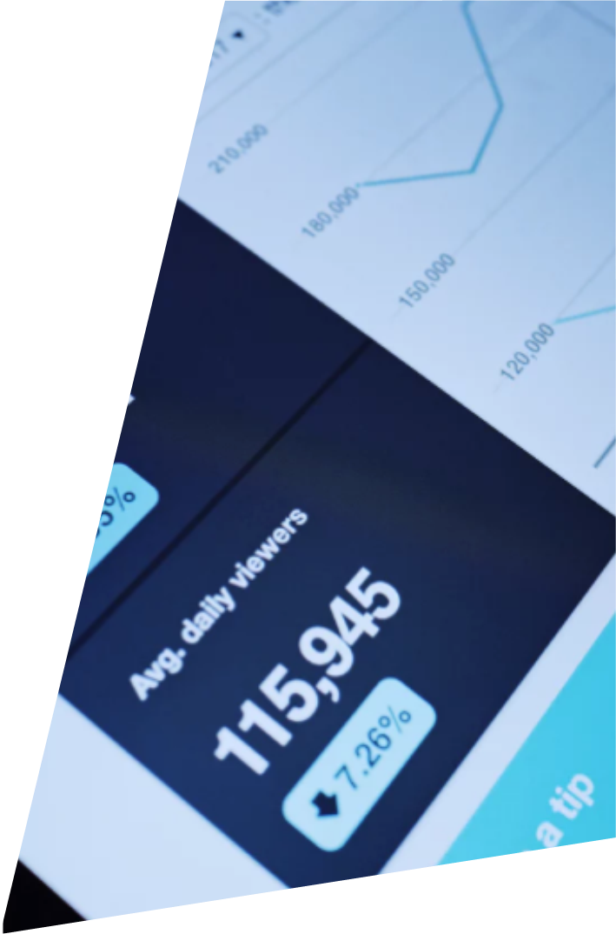
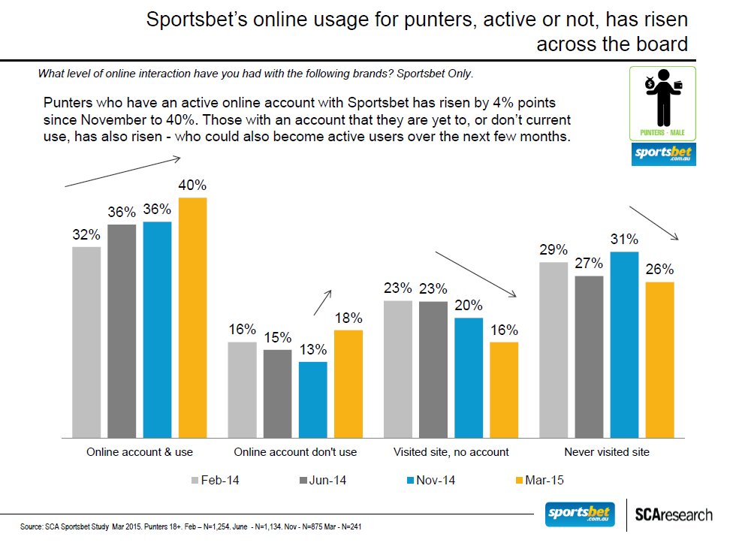
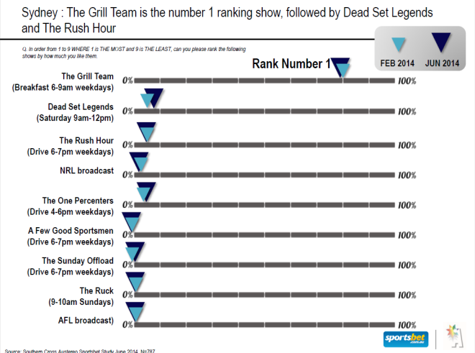
BRAND TRACKING
Traditional Brand Tracking requires a series of surveys to be conducted pre, during and post an advertising campaign.
These surveys ask the same questions across these multiple times with the data being able to track and trend the movements and are normally done every 3-6 months.
By utilising our large national database, and by working with external third party research panels, we can gain adequate sample sizes to filter down into sub groups, which are often not achievable with many research panels. The Southern Cross Austereo Research team also provides expert analysis and full reporting.

Slide 30
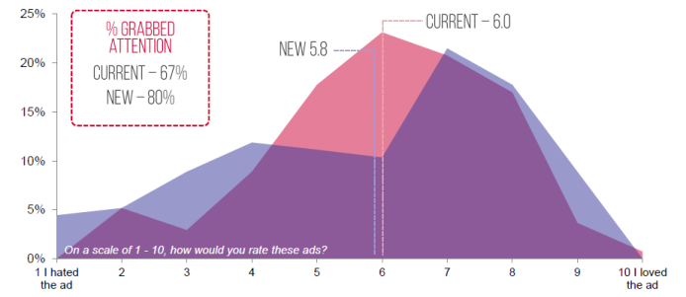
Creative optimization & testing
The effectiveness of any advertising is almost always dependant upon how powerful and creative the actual message is.
Spending large sums of dollars to purchase media, only to have a campaign fail due to the wrong message being delivered, in the wrong way, or even in a non-creative way is a very expensive exercise.
Southern Cross Austereo Research can utilise a range of metrics including:
Key message cut through and take out;
Likeability
Emotional Impact
Creative and attention grabbing appeal of the ad
Relevancy
Possible actions as a result of hearing the ad
Making adjustments to the actual commercials prior to airing ensures much
higher success rates and a greater impact per dollar of media purchased.

Slide 31
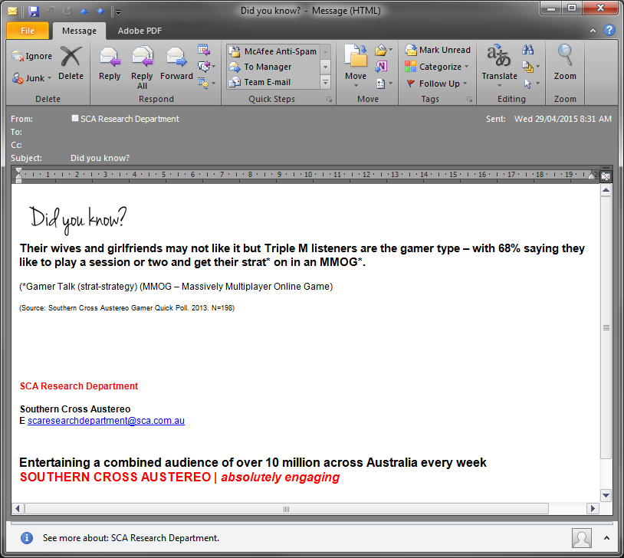
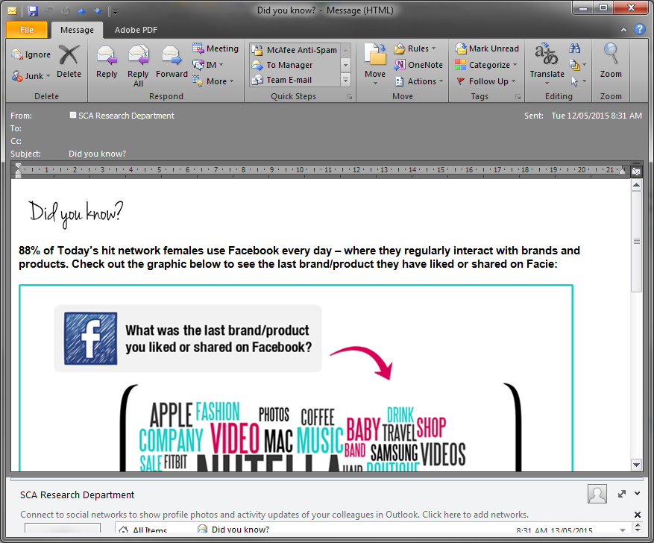
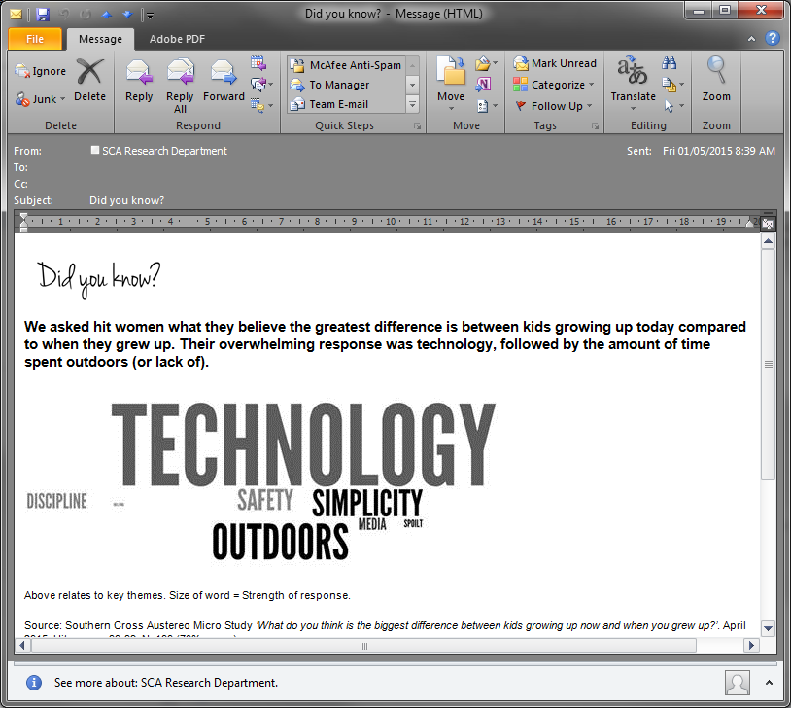
Regular ‘did you know’ emails
In a quest to provide the SCA Sales Teams with as much relevant knowledge and information about our audiences as possible, SCA Research started a daily ‘Did You Know’ e-mail.

